Slide 1
COURSERA CAPSTONE IBM APPLIED DATA SCIENCE CAPSTONE
Setting up a shopping mall in Hyderabad, India
DONE BY
Hiral

Slide 2
BUSINESS PROBLEM
• Location of the shopping mall is one of the most important decisions that will determine whether the mall will be a success or a failure.
• Objective: To analyse and select the best locations in the city of Hyderabad,India to open a new shopping mall.
• This project is timely as the city is currently suffering from oversupply of shopping malls.
• Business question
➢In the city of Hyderabad, if a property developer is looking to open a new shopping mall, where would you recommend that they open it?

Slide 3
DATA
• Data required
➢List of neighbourhoods in Hyderabad
➢Latitude and longitude coordinates of the neighbourhoods
➢Venue data, particularly data related to shopping malls
• Sources of data
➢Wikipedia page for neighbourhoods
(https://en.wikipedia.org/wiki/Category:Neighbourhoods_in_Hyderabad,_India)
➢Geocoder package for latitude and longitude coordinates
➢Foursquare API for venue data

Slide 4
METHODOLOGY
• Web scraping Wikipedia page for neighbourhoods list
• Get latitude and longitude coordinates using Geocoder
• Use Foursquare API to get venue data
• Group data by neighbourhood and taking the mean of the frequency of occurrence of each venue category
• Filter venue category by Shopping Mall
• Perform clustering on the data by using k-means clustering
• Visualize the clusters in a map using Folium

Slide 5
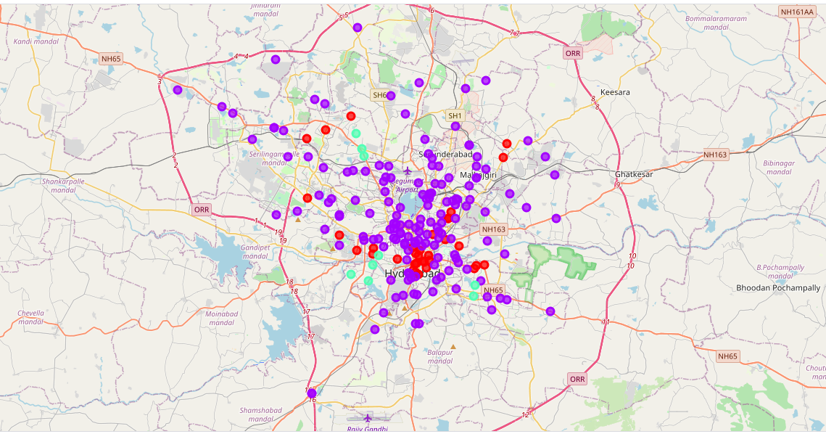
RESULTS
• Categorized the neighbourhoods
into 3 clusters :
➢Cluster 0: Neighbourhoods with
very less number of shopping malls
➢Cluster 1: Neighbourhoods with
very a moderate concentration of shopping malls
➢Cluster 2: Neighbourhoods with a high concentration of shopping
malls.

Slide 6
DISCUSSION
• A good number of shopping malls are concentrated in the central area of the city
• Highest number in cluster 2 and moderate number in cluster 1
• Cluster 0 has very low number to no shopping mall in the neighbourhoods
•Therefore,the project recommends the property developers to capitalize on these findings to open new shopping malls in neighbourhoodsin cluster 0 with little or no competition.

Slide 7
RECOMMENDATIONS
• Open new shopping malls in neighbourhoods in cluster 0 with little to no competition
• Can also open in neighbourhoods in cluster 1 with moderate competition if have unique selling propositions to stand out from the competition.
• Avoid neighbourhoods in cluster 2, already high concentration of shopping malls and intense competition.

Slide 8
CONCLUSIONS
• Answer to business question: The neighbourhoods in cluster 0 are the most preferred locations to open a new shopping mall
• Findings of this project will help the relevant stakeholders to capitalize on the opportunities on high potential locations while avoiding overcrowded areas in their decisions to open a new shopping mall.

Slide 9
THANK YOU!

